Slide 1
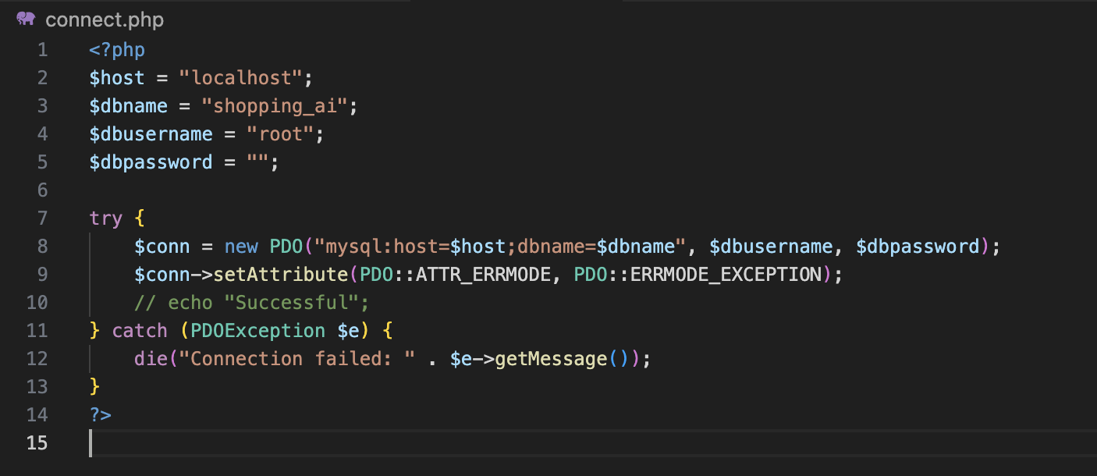
Connect SQL

Slide 2
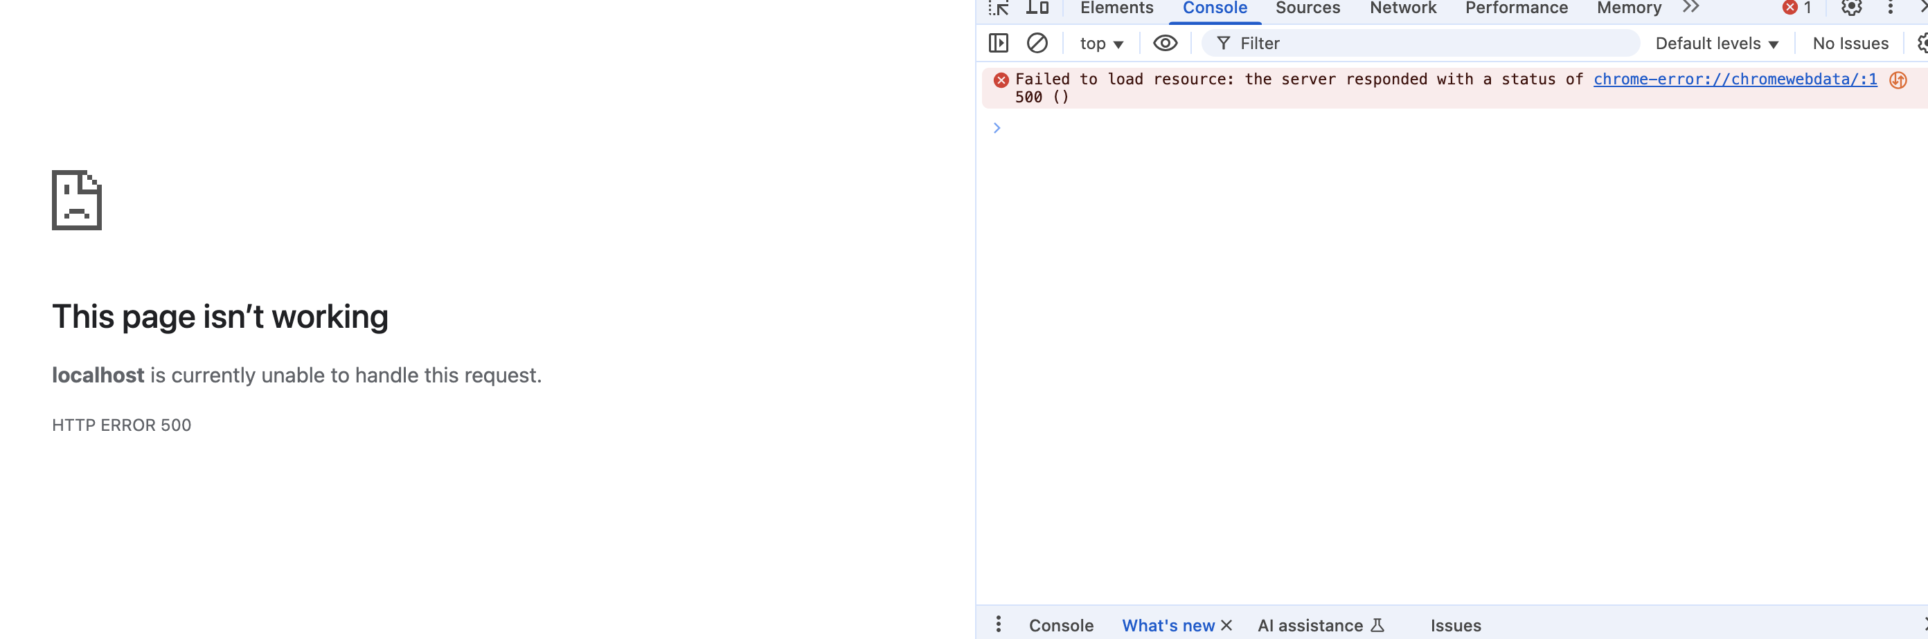
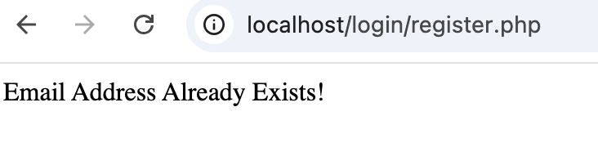
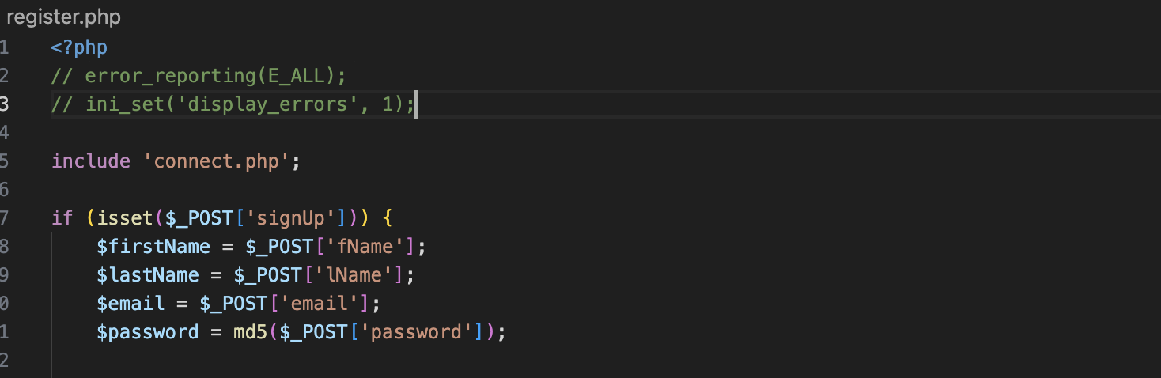
Debug
Fatal error: Uncaught PDOException: SQLSTATE[HY000]: General error: 1364 Field 'id' doesn't have a default value in /Applications/XAMPP/xamppfiles/htdocs/login/register.php:28 Stack trace: #0 /Applications/XAMPP/xamppfiles/htdocs/login/register.php(28): PDOStatement->execute() #1 {main} thrown in /Applications/XAMPP/xamppfiles/htdocs/login/register.php on line 28
ALTER TABLE users MODIFY COLUMN id INT NOT NULL AUTO_INCREMENT;

